Slide 1


Automatic Water Level Controller with Mobile App
IoT-Based Smart Water Management System for Real-time Monitoring and Automatic Control

Slide 2

The Water Management Challenge
Traditional manual monitoring creates significant inefficiencies and risks for property owners worldwide.
Excessive Wastage
Rising Energy Costs
Up to 30% of water wasted annually through tank overflow due to inadequate monitoring systems
Pump overrun significantly increases electricity consumption, adding unnecessary expense to monthly bills
Equipment Damage
Limited Visibility
Dry running causes severe pump damage, resulting in costly repairs and premature replacement
No real-time insights when away from property, leaving systems unmonitored for extended periods

Slide 3
Market Opportunity
Massive Growth Potential
$21.4B
70%
The global smart water management market is experiencing explosive growth, projected to reach $21.4 billion by 2028 as consumers seek automated solutions.
Market Value 2028
Manual Systems
Currently, 70% of households worldwide still rely on inefficient manual monitoring methods, representing an enormous untapped market opportunity.
Target Segments
Residential homes and apartments
Hotels and hospitality facilities
Rising utility costs and environmental awareness are accelerating adoption across residential, commercial, and industrial sectors.
Hospitals and healthcare centres
Industrial complexes

Slide 4
Our Intelligent Solution
Automatic Pump Control
Real-time Mobile Dashboard
Manual Override Capability
Intelligent system automatically activates and deactivates pumps based on precise water level measurements, eliminating manual intervention
Comprehensive monitoring interface provides instant visibility into water levels, pump status, and system health from anywhere
Flexible control allows users to manually operate pumps when needed whilst maintaining automated protection features
Instant Alert System
Comprehensive Pump Protection
Proactive notifications warn of critical conditions including overflow risk, dry-run scenarios, and connectivity issues
Advanced dry-run detection prevents costly equipment damage by automatically shutting down pumps when water levels are critically low

Slide 5
Technology Stack
Built on robust, industry-standard components ensuring reliability, scalability, and ease of maintenance.
01
01
Sensor Layer
Frontend Interface
Ultrasonic HC-SR04 sensors or float switches for precise water level detection
React framework with TypeScript for type-safe, responsive user interfaces
02
02
Styling Framework
Control Processing
Tailwind CSS for modern, consistent, and mobile-optimised design
ESP32 or Arduino microcontroller for intelligent decision-making and pump control
03
03
Application Platform
Communication Protocol
Progressive Web App architecture enabling installation and offline functionality
WiFi connectivity with MQTT messaging for reliable, real-time data transmission

Slide 6





System Architecture
Continuous Sensing
Sensors measure water levels with high precision at regular intervals
Intelligent Processing
Controller analyses data and executes pump control logic automatically
Cloud Communication
Real-time data transmitted securely to cloud infrastructure via WiFi
User Interface
Mobile app displays live status, enabling remote monitoring and control
Flexible Operation
Seamless switching between automatic and manual control modes

Slide 7
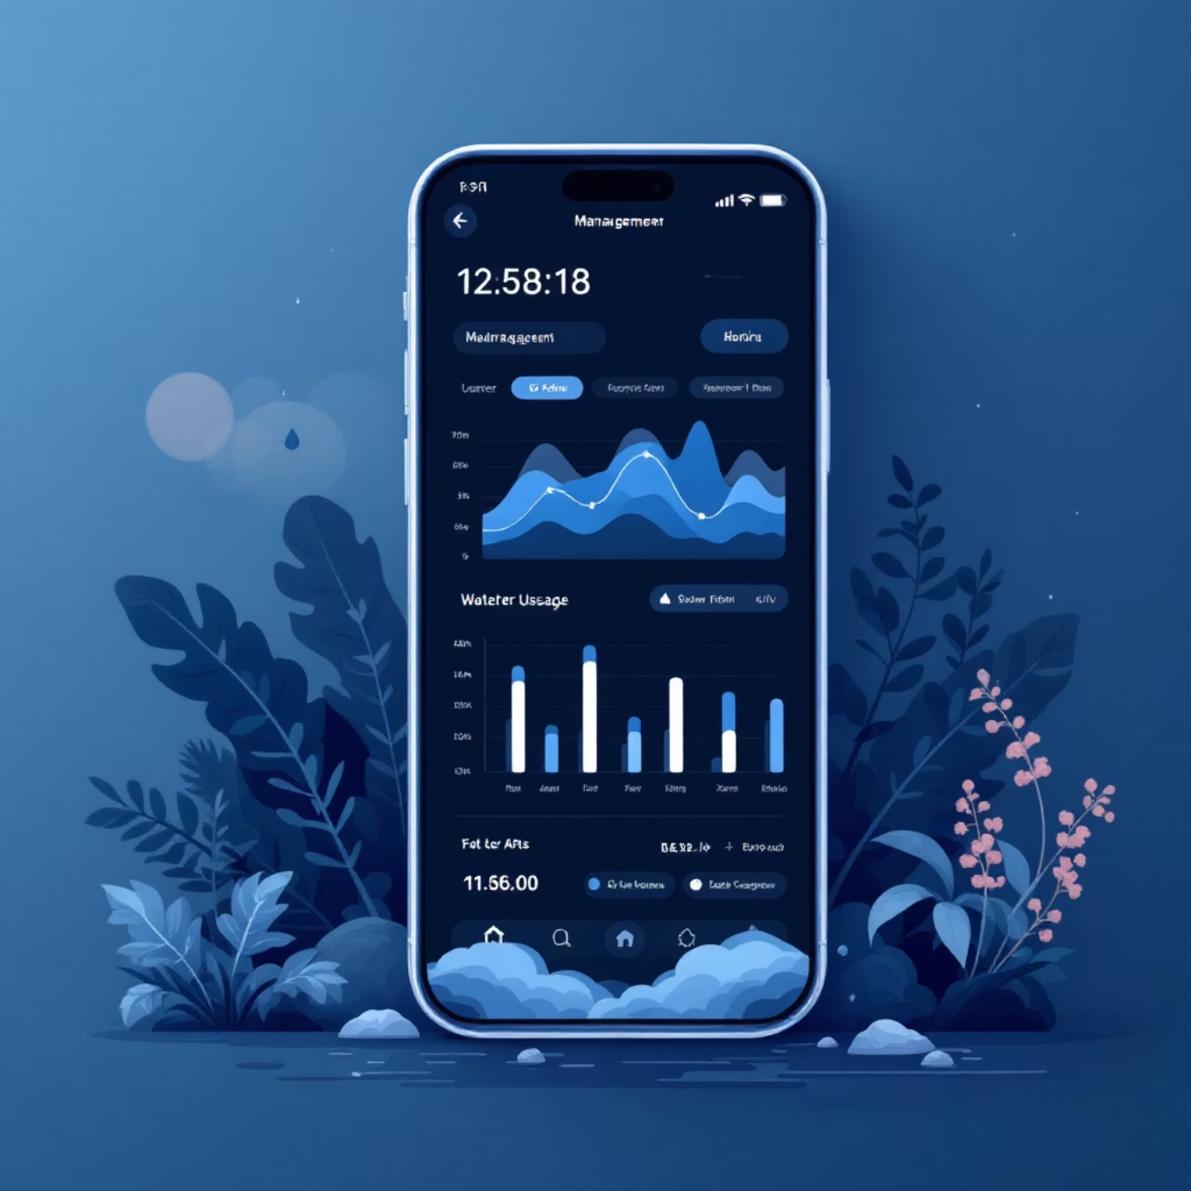
Feature-Rich Dashboard
Comprehensive Monitoring Capabilities
Live Water Level Display
Precise percentage-based readouts updated in real-time with visual indicators
Intelligent Automation
Automatic pump activation at low threshold, deactivation when full
Manual Control Override
One-touch manual operation with maintained safety protections
System Health Status
Instant connectivity indicators and device status monitoring
Alert Management
Comprehensive notification history with detailed event logging
Modern Dark Interface
Eye-friendly themed dashboard optimised for extended viewing

Slide 8


Measurable Benefits
Delivering substantial value across environmental sustainability, cost savings, and operational efficiency.
30%
25%
Water Conservation
Energy Savings
Reduction in wastage through overflow prevention
Lower electricity bills from optimised pump operation
Equipment Longevity
Ultimate Convenience
Dry-run protection significantly extends pump lifespan, reducing replacement frequency and maintenance costs
Complete peace of mind with remote monitoring capabilities from anywhere in the world via smartphone

Slide 9
Competitive Advantage
Affordable Entry Point
Intuitive User Experience
Zero Recurring Fees
Complete system components cost just $30-50, making smart water management accessible to all property types and budgets
Carefully designed interface requires no technical expertise, with clear visual indicators and straightforward controls
No monthly subscriptions or hidden costs—full functionality with one-time hardware investment only
Highly Scalable Design
Open Standards
Architecture supports expansion from single residential tanks to multi-facility commercial deployments with customisation options
Built on industry-standard protocols ensuring compatibility, easy maintenance, and future integration possibilities

Slide 10
Future Development Roadmap
Strategic enhancements planned to expand functionality and deliver even greater value to users.
Advanced Analytics
Detailed water consumption tracking with usage patterns, trend analysis, and efficiency recommendations
Predictive Maintenance
Machine learning algorithms to forecast equipment issues and schedule preventive maintenance proactively
Voice Integration
Seamless control through Amazon Alexa, Google Assistant, and Apple Siri for hands-free operation
Multi-Tank Management
Unified dashboard supporting multiple tanks across different locations with coordinated control
Quality Monitoring
Additional sensors for pH levels, turbidity, and contamination detection ensuring water safety

